Slide 1
hOW TO HANDLE LARGE DATA SET USING BIONFORMATICS TOOLS
Giulia Leone(S3494225) Fiona Carey(S3307786)

Slide 2
CTD data obtained from ROV on board a ship in the NE Atlantic
Large data file which was divided into 2 data set
Data taken for the first 10 m depth
Data condensed into every 30 minutes
Jedit
Excel
R studio
Excel
Python
R studio
Graph of salinity vs depth
Graph of temperature vs depth
Graph of temperature changes with depth across time

Slide 3
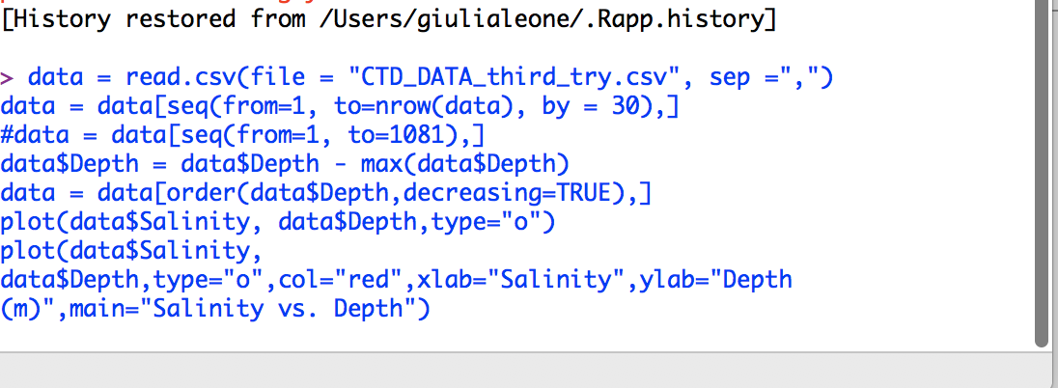
HOW WE DID IT Salinity vs depth graph

Slide 4
Salinity vs depth
The difference between points is minimal
Changes are in the range of 0.05 and smaller
That is expected
Salinity in the ocean doesn’t change significantly

Slide 5
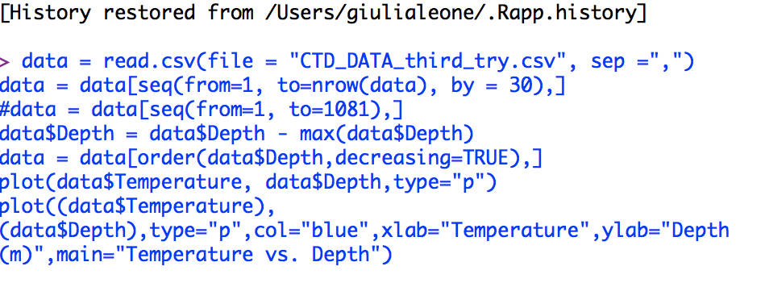
HOW WE DID IT TEMPERATURE VS DEPTH

Slide 6
TEMPERATURE VS DEPTH
The temperature decreases with depth
This is expected because
Lack of thermal radiation
Cold water sinks, warm water rises
With greater depth we expect larger decreases in temperature

Slide 7
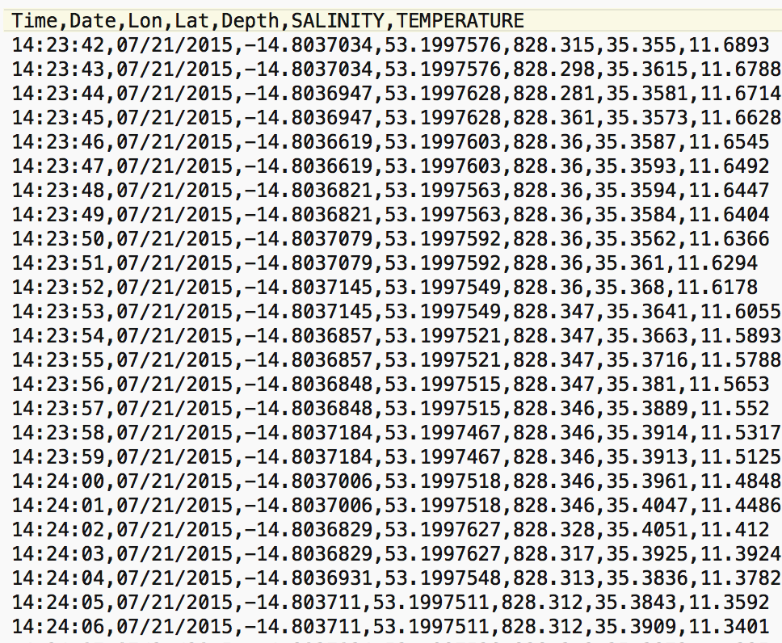
ORIGINAL DATA
Data taken every second
large data file
To much data for R to handle
Repetition of points

Slide 8
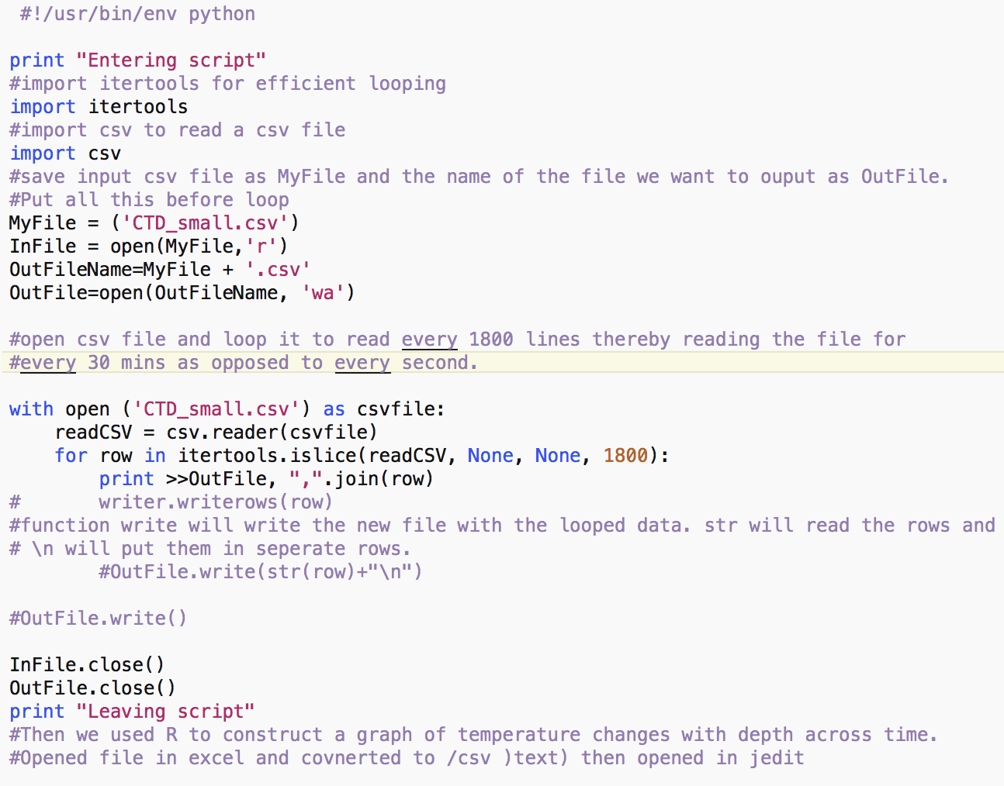
HOW WE DID IT python script
Ran the script in the terminal
Read every 1800 lines
Equivalent to data being read every 30 min
Produced an output file

Slide 9
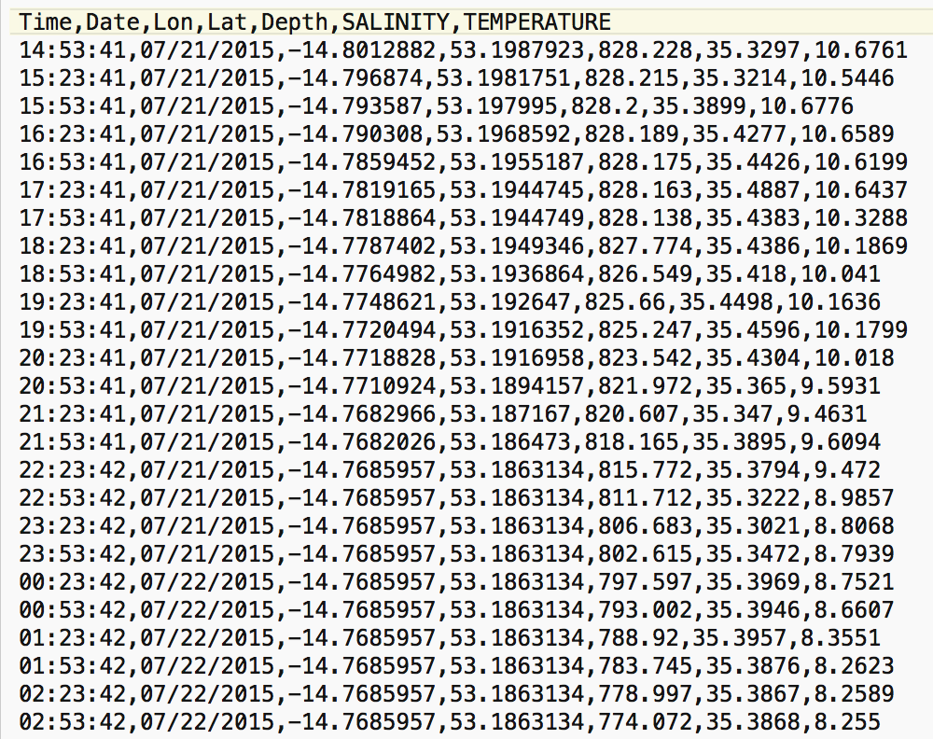
OUTPUT FILE
Data now sorted every 30 minutes
Used this file to create our graph in Rstudio
Smaller and more manageable than before

Slide 10
HOW WE DID IT TEMPERATURE CHANGES WITH DEPTH ACROSS TIME

Slide 11
temperature CHANGES WITH DEPTH ACROSS TIME
Data collection starts at the sea bottom
The blue color indicates WARMER temperature
Red color indicates COOLER temperature
There is a small gradient in temperature with depth

Slide 12
THANK YOU FOR THE ATTENTION!
ANY QUESTIONS?

